Slide 1
Securitisation revised framework
Capital calculations under the revised securitisation framework
Basel III securitisation framework issued in July 2016 and comes into effect in January 2018.
The Basel framework requires banks to hold regulatory capital for securitisation exposures. These include exposures arising from the provision of credit risk mitigants to a securitisation transaction, investments in asset-backed securities, retention of a subordinated tranche, and extension of a liquidity facility or credit enhancement.
Simple, transparent, and comparable (STC) securitisations
The new framework simplify the number of approaches, reduce mechanistic reliance on external ratings and enhance risk sensitivity.
The framework addresses the capital treatment of securitisation (both STC and non-STC), and resecuritisation exposures.
Synthetic securitisations and asset-backed commercial paper (ABCP) securitisations are out of scope for the STC framework (to be included in the revised securitisation framework).
IRBA (internal rating based approach) or ERBA (external rating based approach) provided the exposure is rated (or has an inferred rating), and the jurisdiction permits the use of ratings for regulatory purposes.
If a bank is unable to use even the standardized approach, it must assign a risk weight of 1,250% to the exposure.
securitisation exposures that comply with STC criteria requires less regulatory capital as the prescribed risk weights and risk weights cap for these exposures are lower.

Slide 2
Simple, Transparent and Comparable (1/2)
Simple Transparent and Comparable (STC) securitizazions
Term | Definition
Simplicity | Simplicity refers to the homogeneity of underlying assets with simple characteristics and a transaction structure that is not overly complex.
Transparency | Criteria for transparency provide investors with sufficient information on the underlying assets, the structure of the transaction, and the parties involved in the transaction, promoting a more comprehensive and thorough understanding of the risks involved. Can the information available support the investors in their risk assessment?
Comparability | Criteria promoting comparability could assist investors in their understanding of such investments and enable more straightforward comparison across securitisation products within an asset class. Importantly, they might appropriately account for differences across jurisdictions.
The revised framework has only three approaches (compare to more than six before): internal ratings-based, external ratings-based, and standardized approaches.
The revised approach doesn’t rely anymore on a bank’s role in securitisation (investor or originator), neither on the bank’s credit risk approach. Instead, the approach focus more on the information availability and on the analysis and estimations that a bank can perform.
Extra risk drivers; maturity and tranche thickness for non-senior approaches have been incorporated into the external ratings-based approach to reduce reliance on only external ratings and improve risk sensitivity.
The new framework results in higher capital requirements, commensurate with the risk of securitisation exposures. However, low-risk securitisations that meet the STC criteria do get a more favorable capital treatment (lower risk weight).
Higher risk weights for highly rated securitisation exposures are applied and reduced risk weights for low-rated senior securitisation exposures.

Slide 3
Simple, Transparent and Comparable (2/2)
Simple Transparent and Comparable (STC) securitizazions
Only non-ABCP (Asset-backed commercial paper), traditional securitisations are within the scope of the STC framework. However, the Committee is still considering how STC criteria for short-term securitisations and ABCP conduits/programs should be developed.
Jurisdictions that believe the operational burden of implementing the STC framework exceeds the benefits that can be derived from its implementation retain the option not to implement the STC framework.
Hence, this framework implies that only institutions in jurisdictions that permit the use of STC framework can benefit from the lower capital requirements.

Slide 4
Different approaches
Hierarchy of approaches
The three approaches by hierarchy:
1/ Internal ratings based approach (IRBA)
2/ External rating based approach (ERBA)
3/ Standardized Approach (SA).
To use the IRBA, the banks need supervisory approval and sufficient information to estimate KIRB (the exposure-weighted average capital charge for the underlying pool).
If a bank cannot use the IRBA, it can use the ERBA provided the exposure is rated (or has an inferred rating that meets operational requirements) and the jurisdiction permits the use of ratings for regulatory purpose.
However, if the bank cannot use the IRBA neither ERBA, it should use the Standardized Approach (SA).
A bank that cannot use either of these three approaches for a given securitisation exposure would assign a risk weight of K = 1,250% to that exposure.
If a bank can calculate KIRB for at least 95% of the underlying exposures:
For the IRBA pool, the capital charge = KIRB × % of underlying exposure for which KIRB can be calculated
For the SA pool, the capital charge = KSA × (1 – % of underlying exposure for which KIRB can be calculated)

Slide 5
Capital requirements calculation
Calculation methodology
The risk-weighted asset amount of a securitisation exposure is computed by multiplying the exposure amount by the appropriate risk weight, determined in accordance with the hierarchy of approaches.
The exposure amount of a securitisation exposure is the sum of the on-balance sheet exposure amount, or carrying value (purchase discounts and write-downs / specific provisions), and the off-balance sheet exposure amount, where applicable.
Under all three approaches in the hierarchy, the risk weight for STC-compliant securitisations is subject to a floor of 10% for senior tranches and 15% for non-senior tranches. For the same exposures, SA generates higher capital requirements than IRBA and ERBA.

Slide 6
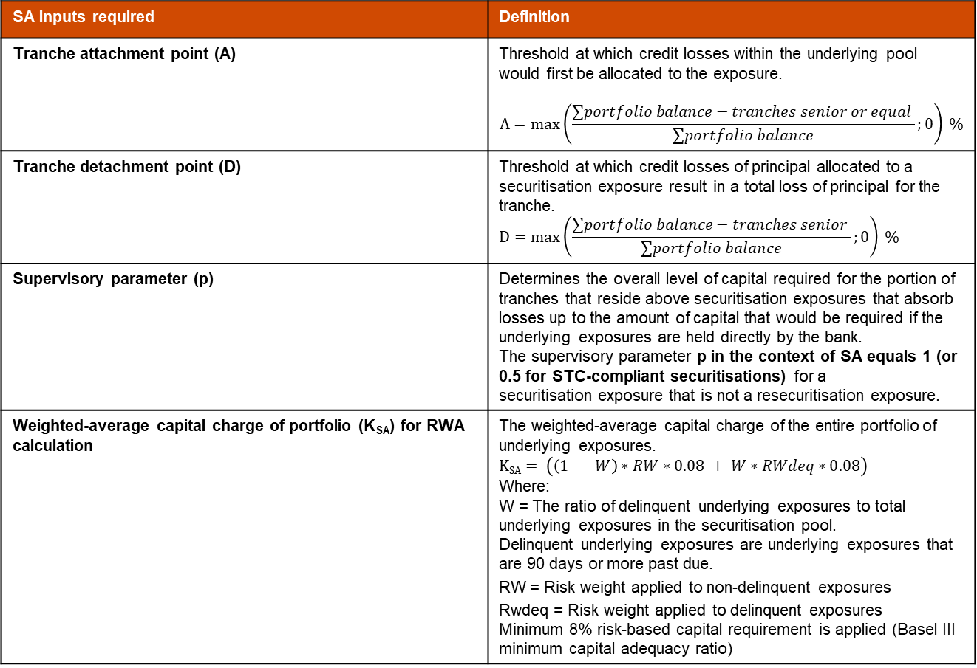
Required inputs for calculation (1/2)
SA inputs required | Definition
Tranche attachment point (A) | Threshold at which credit losses within the underlying pool would first be allocated to the exposure. $$A=max\left(\frac{∑portfolio balance−tranches senior or equal }{∑portfolio balance};0\right) \%$$
Tranche detachment point (D) | Threshold at which credit losses of principal allocated to a securitisation exposure result in a total loss of principal for the tranche. $$D=max\left(\frac{∑portfolio balance−tranches senior }{∑portfolio balance};0\right) \%$$
Supervisory parameter (p) | Determines the overall level of capital required for the portion of tranches that reside above securitisation exposures that absorb losses up to the amount of capital that would be required if the underlying exposures are held directly by the bank. The supervisory parameter p in the context of SA equals 1 (or 0.5 for STC-compliant securitisations) for a securitisation exposure that is not a resecuritisation exposure.
Weighted-average capital charge of portfolio (K_{SA}) for RWA calculation | The weighted-average capital charge of the entire portfolio of underlying exposures. $$KSA= \left(\left(1 − W\right)∗RW∗0.08 + W∗RWdeq∗0.08\right)$$ Where: W = The ratio of delinquent underlying exposures to total underlying exposures in the securitisation pool. Delinquent underlying exposures are underlying exposures that are 90 days or more past due. RW = Risk weight applied to non-delinquent exposures Rwdeq = Risk weight applied to delinquent exposures Minimum 8% risk-based capital requirement is applied (Basel III minimum capital adequacy ratio)

Slide 7
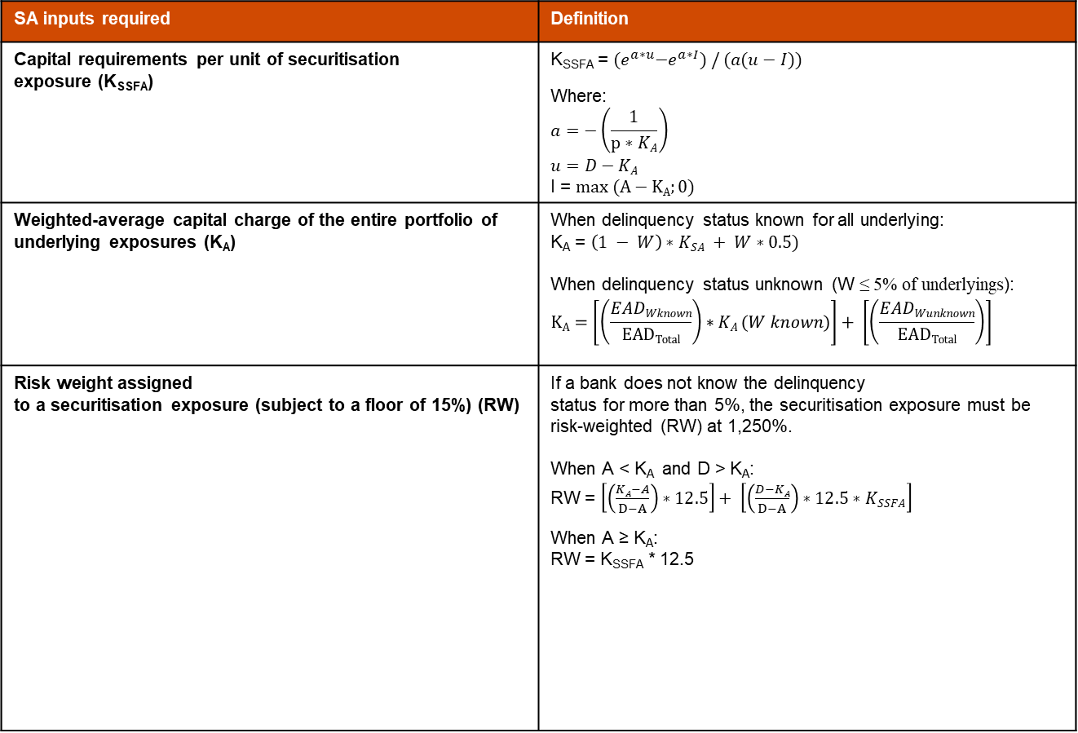
Required inputs for calculation (2/2)
SA inputs required | Definition
Capital requirements per unit of securitisation exposure (K_{SSFA}) | K_{SSFA} = ${(e}^{a∗u}−e^{a∗I}) / (a(u−I))$ Where: $$a=−\left(\frac{1}{p∗KA}\right)$$ $$u=D−KA$$ I = $max (A−KA;0)$
Weighted-average capital charge of the entire portfolio of underlying exposures (K_{A}) | When delinquency status known for all underlying: K_{A} = $\left(1 − W\right)∗KSA + W∗0.5)$ When delinquency status unknown (W ≤ 5% of underlyings): $$KA=\left[\left(\frac{EADWknown}{EADTotal}\right)∗KA (W known)\right]+ \left[\left(\frac{EADWunknown}{EADTotal}\right)\right]$$
Risk weight assigned to a securitisation exposure (subject to a floor of 15%) (RW) | If a bank does not know the delinquency status for more than 5%, the securitisation exposure must be risk-weighted (RW) at 1,250%. When A < K_{A} and D > K_{A}: RW = $\left[\left(\frac{KA−A}{D−A}\right)∗12.5\right]+ \left[\left(\frac{D−KA}{D−A}\right)∗12.5∗KSSFA\right]$ When A ≥ K_{A}: RW = K_{SSFA} * 12.5

Slide 8
Securitisation capital charge calculations examples (1/2)
Example of the capital requirements calculations for the following portfolio
Assumptions:
The bank owns $10,000 in each of A1,A2,B,C and Subordinate tranches.
The average capital charge of underlying assets in the pool is 8% (Basel III minimum capital adequacy ratio).
5.0% of assets in the pool are delinquent and receive a 150% risk weight (or 12% capital charge).
The pool does not contain any securitzation tranches or assets that have credit subordination, i.e., it is not a re-securitisation.
Tranche | Type | Current Balance | Subordination Structure
A1 | SENIOR - Short-term debt | $ 44'113'308 | 1
A2 | SENIOR - Long-term debt | $ 393'755'394 | 1
B | MEZZANINE | $ 42'000'000 | 2
C | MEZZANINE | $ 42'000'000 | 3
SUBORD | JUNIOR | $ 53'200'000 | 4
Overcollateralization / Cash Reserves |  | $ 1'000'000 | 5

Slide 9
Securitisation capital charge calculations examples (1/2)
Capital requirements calculations of the four tranches of the portfolio
SENIOR - Short/Long-term debt |  |  | B | MEZZANINE |  | C | MEZZANINE |  | SUBORD | JUNIOR
p | 0.5 |  | p | 0.5 |  | p | 0.5 |  | p | 0.5
A | 23.99% |  | A | 16.70% |  | A | 9.41% |  | A | 0.17%
D | 100.00% |  | D | 23.99% |  | D | 16.70% |  | D | 9.41%
W | 5% |  | W | 5% |  | W | 5% |  | W | 5%
Ksa | 0.082 |  | Ksa | 0.082 |  | Ksa | 0.082 |  | Ksa | 0.082
a | -19.43634597 |  | a | -19.43634597 |  | a | -19.436346 |  | a | -19.436346
u | 0.8971 |  | u | 0.13700 |  | u | 0.064094 |  | u | -0.008814
I | 0.137002 |  | I | 0.064094 |  | I | 0.000000 |  | I | 0.000000
KA | 0.1029 |  | KA | 0.1029 |  | KA | 0.1029 |  | KA | 0.1029
KSSFA(KA) | 0.47% |  | KSSFA(KA) | 15.38% |  | KSSFA(KA) | 57.18% |  | KSSFA(KA) | 109%
KSSFA(KA) in $ | 47 |  | KSSFA(KA) in $ | 1'538 |  | KSSFA(KA) in $ | 5'718 |  | KSSFA(KA) in $ | 10'908
Risk weight | 21% |  | Risk weight | 192% |  | Risk weight | 779% |  | Risk weight | 1250%
When A > KA |  |  |  |  |  | when A < KA and D > KA |  |  | When D <= KA
--> Risk weight = KSSFA(KA) * 12.5 + floor of 0.15
Calculations examples file:

Slide 10
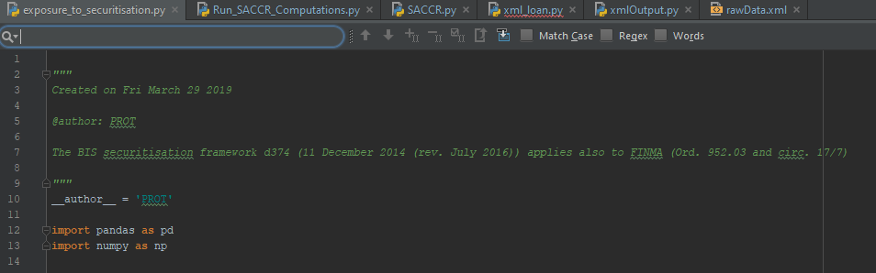
Securitisation capital charge calculation tool (1/2)
A first version of the securitisation capital charge tool has been built in the engine
Code name: exposure_to_securitisation.py to be run
Path: C:\Users\UWXYZ\Desktop\SVN\trunk\CrKappa\securitisation
Python libraries required: pandas and numpy
Input file: Raw_Data.xlsx
Output file: output.xls
Can calculate thousands positions (Excel line limitation) on multiple portfolios

Slide 11
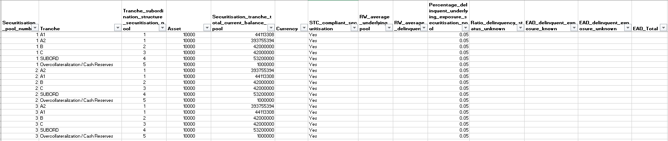
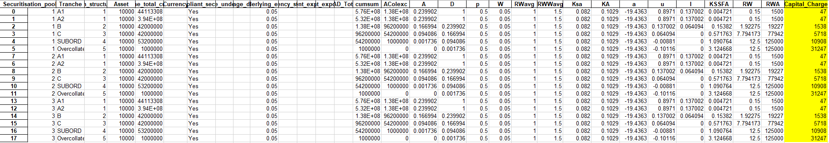
Securitisation capital charge calculation tool (2/2)
Calculations input and results files are in Excel format
Input file: Raw_Data.xlsx (the filled columns are mandatory)
Output file: output.xls

